Slide 1
Basics of programming (note: this should be revision)
Built in types
Conditionals
Loops
Arrays
I/O

Slide 2
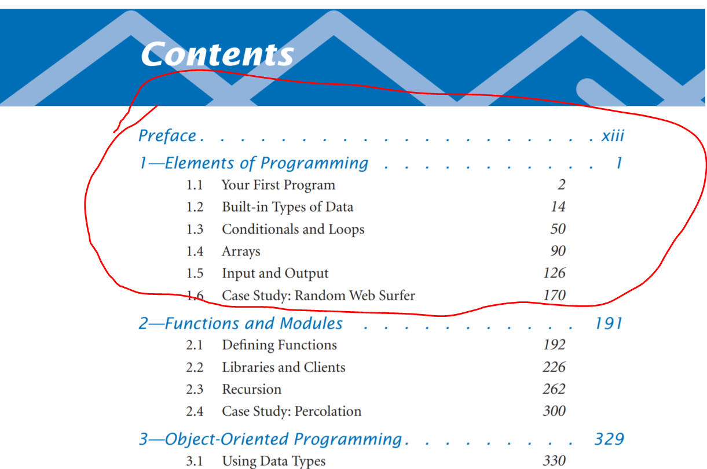
Review
See textbook Sedgwick Ch 1 for a complete review…

Slide 3
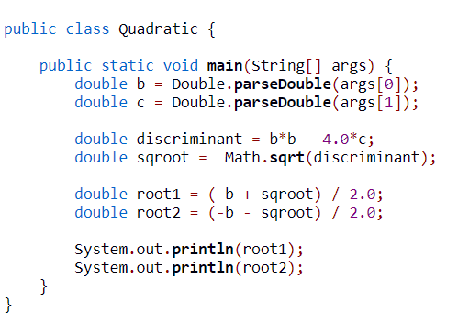

Example of inbuilt type double
Compilation: javac Quadratic.java
Execution: java Quadatic b c
Given b and c, solves for the roots of x*x + b*x + c.
Quadratic formula (the implementation assumes a = 1)
$$x=\frac{−b±\sqrt{b^{2}−4ac}}{2a}$$

Slide 4
Loops
Simulation: gamblers ruin
Suppose that a gambler makes a series of fair $1 bets, starting with some given initial stake. The gambler always goes broke eventually, but when we set other limits on the game, various questions arise.
For example, suppose that the gambler decides ahead of time to walk away after reaching a certain goal. What are the chances that the gambler will win? How many bets might be needed to win or lose the game? What is the maximum amount of money that the gambler will have during the course of the game?
probability of success is the ratio of the stake to the goal and that the expected number of bets is the product of the stake and the desired gain (the difference between the goal and the stake). For example, if you go to Monte Carlo to try to turn $500 into $2,500, you have a reasonable (20%) chance of success, but you should expect to make a million $1 bets! If you try to turn $1 into $1,000, you have a 0.1% chance and can expect to be done (ruined, most likely) in about 999 bets.

Slide 5
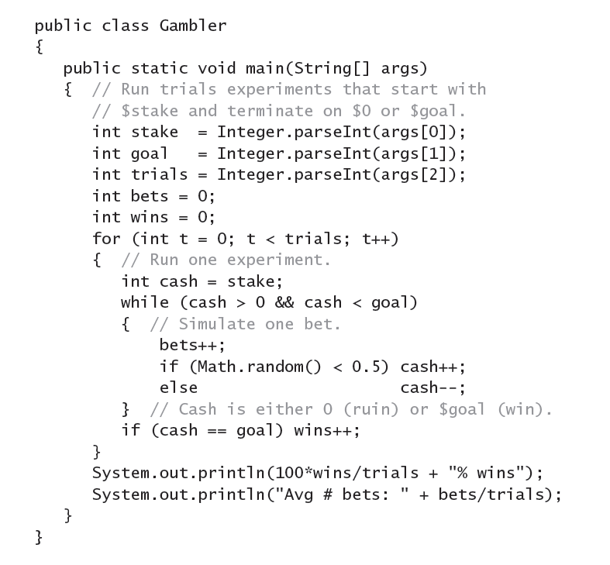
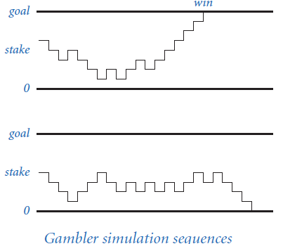
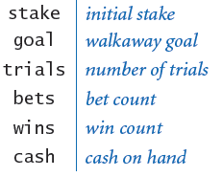
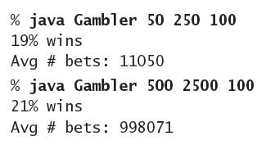
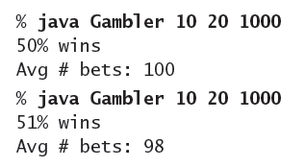
Runtime = trials * bets
Notes:
This program takes three integers command-line arguments stake, goal, and trials. The
inner while loop in this program simulates a gambler with $stake who makes a series of $1
bets, continuing until going broke or reaching $goal. The running time of this program is proportional
to trials times the average number of bets. For example, the third command below
causes nearly 100 million random numbers to be generated.
Gambler (Program 1.3.8) is a simulation that
can help answer these questions. It does a sequence
of trials, using Math.random() to simulate the sequence
of bets, continuing until either the gambler
is broke or the goal is reached, and keeping track of
the number of times the gambler reaches the goal
and the number of bets. After running the experiment
for the specified number of trials, it averages and prints the results. You might
wish to run this program for various values of the command-line arguments, not
necessarily just to plan your next trip to the casino, but to help you think about the
following questions: Is the simulation an accurate reflection of what would happen
in real life? How many trials are needed to get an accurate answer? What are
the computational limits on performing such a simulation? Simulations are widely
used in applications in economics, science, and engineering, and questions of this
sort are important in any simulation.

Slide 6
Finding factors
Factoring. A prime number is an integer greater than 1 whose only positive divisors are 1 and itself. The prime factorization of an integer is the multiset of primes whose product is the integer. For example, 3,757,208 = 2 x 2 x 2 x 7 x 13 x 13 = 397.
Here is a class Factors to compute the prime factorization of any given positive integer.

Slide 7
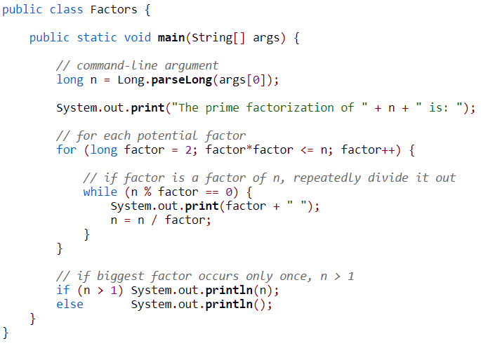
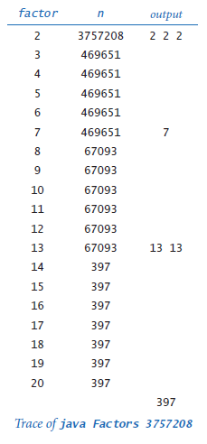
% java Factors 3757208
2 2 2 7 13 13 397
* % java Factors 81
* The prime factorization of 81 is: 3 3 3 3
*
* % java Factors 168
* The prime factorization of 168 is: 2 2 2 3 7
Notes:
Computes the prime factorization of n using brute force.
Although Factors is compact, it certainly will take some thought to convince
yourself that it produces the desired result for any given integer. As usual, following
a trace that shows the values of the variables at the beginning of each iteration
of the outer for loop is a good way to understand the computation. For the case
where the initial value of n is 3757208, the inner while loop iterates three times
when factor is 2, to remove the three factors of 2; then zero
times when factor is 3, 4, 5, and 6, since none of those
numbers divides 469651; and so forth. Tracing the program
for a few example inputs reveals its basic operation. To convince
ourselves that the program will behave as expected for
all inputs, we reason about what we expect each of the loops
to do. The while loop prints and removes from n all factors
of factor, but the key to understanding the program is to
see that the following fact holds at the beginning of each
iteration of the for loop: n has no factors between 2 and
factor-1. Thus, if factor is not prime, it will not divide
n; if factor is prime, the while loop will do its job. Once
we know that n has no divisors less than or equal to factor,
we also know that it has no factors greater than n/factor,
so we need look no further when factor is greater than n/
factor.

Slide 8
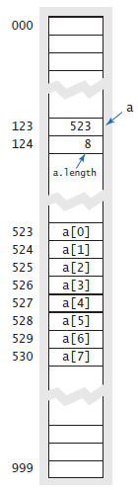
Arrays
Memory representation
int[] a = new int [7];
When you use the keyword new to create an array, Java reserves sufficient space in memory to store the specified number of elements. This process is called memory allocation. The same process is required for all variables that you use in a program (but you do not use the keyword new with variables of primitive types because Java knows how much memory to allocate). It is your responsibility to create an array before accessing any of its elements. If you fail to adhere to this rule, you will get an uninitialized variable error at compile time.

Slide 9
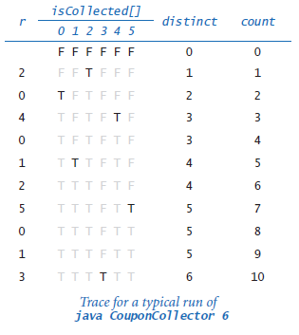

Arrays
Simulation
Example: coupon collector
“How many cards do you need to turn up before you have seen one of each suit?”

Slide 10
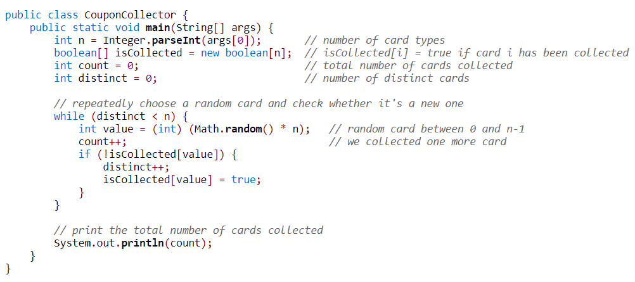

Slide 11
Sieve of Eratosthenes
An algorithm for making tables of primes. Sequentially write down the integers from 2 to the highest number n you wish to include in the table. Cross out all numbers >2 which are divisible by 2 (every second number). Find the smallest remaining number >2. It is 3. So cross out all numbers >3 which are divisible by 3 (every third number). Find the smallest remaining number >3. It is 5. So cross out all numbers >5 which are divisible by 5 (every fifth number).
The sieve of Eratosthenes can be used to compute the prime counting function.
The prime counting function π(n) is the number of primes less than or equal to n. For example π(17) = 7 since the first seven primes are 2, 3, 5, 7, 11, 13, and 17.
https://mathworld.wolfram.com/PrimeCountingFunction.html
https://mathworld.wolfram.com/SieveofEratosthenes.html

Slide 12

Sieve of Eratosthenes
n Primes <= n
---------------------------------
10 4
100 25
1,000 168
10,000 1,229
100,000 9,592
1,000,000 78,498
10,000,000 664,579
100,000,000 5,761,455
1,000,000,000 50,847,534

Slide 13
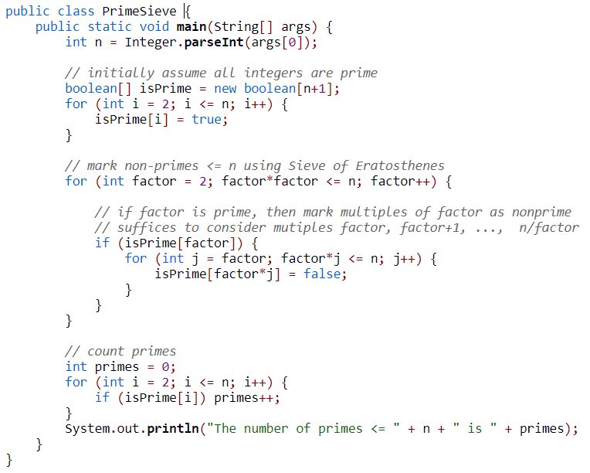

Slide 14
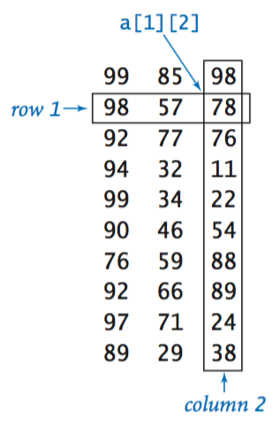
Arrays
2 dimensions
double[][] a = new double[m][n];
Two-dimensional arrays in Java. To refer to the element in row i and column j of a two-dimensional array a[][], we use the notation a[i][j]; to declare a two-dimensional array, we add another pair of brackets; to create the array, we specify the number of rows followed by the number of columns after the type name…
Notes:
We refer to such an array as an m-by-n array. By convention, the first dimension is the number of rows and the second dimension is the number of columns.

Slide 15
Initialize an array
double[][] a;
a = new double[m][n];
for (int i = 0; i < m; i++)
for (int j = 0; j < n; j++)
a[i][j] = 0;

Slide 16
Memory representation. Java represents a two-dimensional array as an array of arrays. A matrix with m rows and n columns is actually an array of length m, each entry of which is an array of length n. In a two-dimensional Java array, we can use the code a[i] to refer to the ith row (which is a one-dimensional array). Enables ragged arrays.

Slide 17
Setting values at compile time.
To initialize an 11-by-4 array a[][]:
double[][] a = {
{ 99.0, 85.0, 98.0, 0.0 },
{ 98.0, 57.0, 79.0, 0.0 },
{ 92.0, 77.0, 74.0, 0.0 },
{ 94.0, 62.0, 81.0, 0.0 },
{ 99.0, 94.0, 92.0, 0.0 },
{ 80.0, 76.5, 67.0, 0.0 },
{ 76.0, 58.5, 90.5, 0.0 },
{ 92.0, 66.0, 91.0, 0.0 },
{ 97.0, 70.5, 66.5, 0.0 },
{ 89.0, 89.5, 81.0, 0.0 },
{ 0.0, 0.0, 0.0, 0.0 }
};

Slide 18
Ragged arrays
for (int i = 0; i < a.length; i++) {
for (int j = 0; j < a[i].length; j++) {
System.out.print(a[i][j] + " ");
}
System.out.println();
}
There is no requirement that all rows in a two-dimensional array have the same length—an array with rows of nonuniform length is known as a ragged array. The possibility of ragged arrays creates the need for more care in crafting array-processing code.

Slide 19
Multidimensional arrays
double[][][] a = new double[n][n][n];
3 dimensions
a[i][j][k]

Slide 20
Matrix operations
Exercise
Write code to add 2 n x n matrices.
Write code to multiply 2 n x n matrices.

Slide 21
Add
double[][] c = new double[n][n];
for (int i = 0; i < n; i++) {
for (int j = 0; j < n; j++) {
c[i][j] = a[i][j] + b[i][j];
}
}

Slide 22
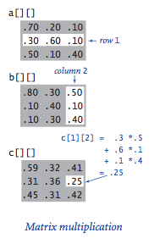
Multiply
Each entry c[i][j] in the product of a[] and b[] is computed by taking the dot product of row i of a[] with column j of b[]

Slide 23
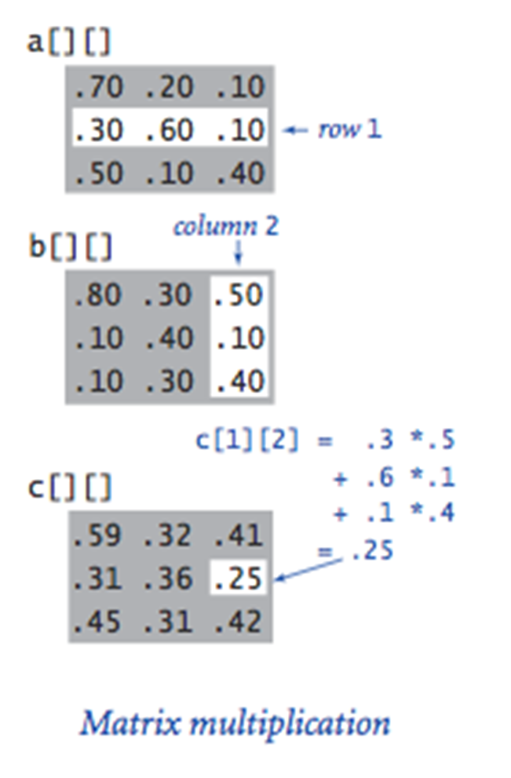
Multiply
double[][] c = new double[n][n];
for (int i = 0; i < n; i++) {
for (int j = 0; j < n; j++) {
for (int k = 0; k < n; k++) {
c[i][j] += a[i][k]*b[k][j];
}
}
}

Slide 24
Magic Square
A n by n magic square is an n x n matrix with the integer 1 .. n^2 exactly once, with the constraints that the rows, columns and diagonals all are equal.
One simple algorithm is to assign the integers 1 to n^2 in ascending order, starting at the bottom, middle cell. Repeatedly assign the next integer to the cell adjacent diagonally to the right and down. If this cell has already been assigned another integer, instead use the cell adjacently above. Use wrap-around to handle border cases.

Slide 25
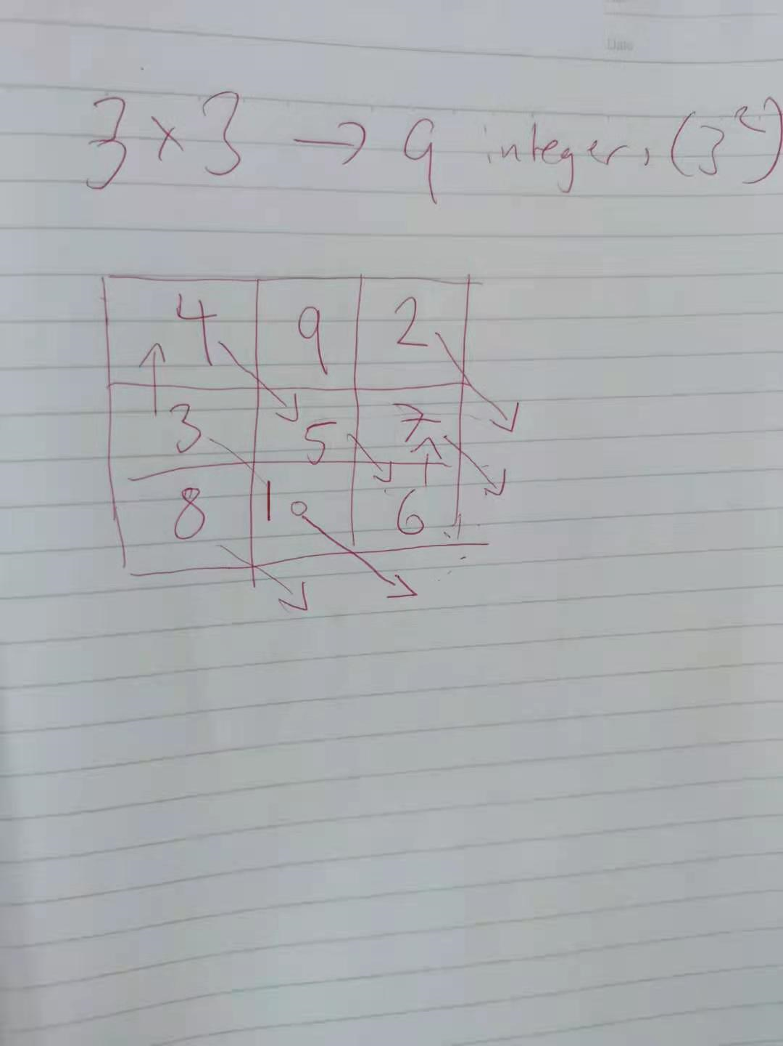
One simple algorithm is to assign the integers 1 to n^2 in ascending order, starting at the bottom, middle cell. Repeatedly assign the next integer to the cell adjacent diagonally to the right and down. If this cell has already been assigned another integer, instead use the cell adjacently above. Use wrap-around to handle border cases.

Slide 26
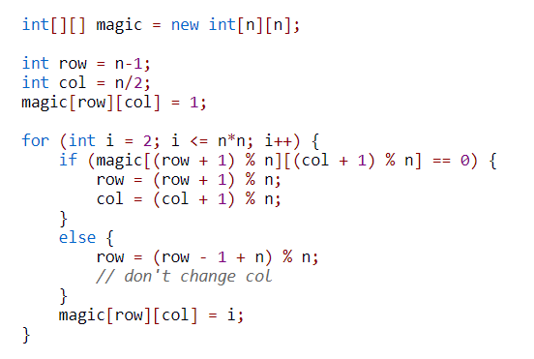

Slide 27
